Slide 1
DR SNSRCAS, CBE Human Centered Design Thinking Fundamentals 21PCA204 I MCA ODD SEM UNIT 1 The Kickoff Meeting-

Slide 2
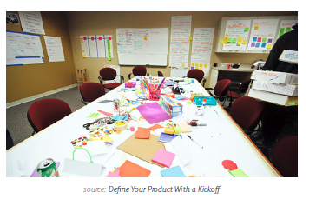
The Kickoff Meeting-
The kickoff meeting covers the high-level outline of the product purpose, who is
involved in designing and developing a product, how they’ll work together and stay
up-to-date on the progress, and what the intended results or success metrics are.

Slide 3
The Kickoff Meeting-
The process is becoming shorter and shorter as teams become more nimble and
projects more lean, and the documentation can be presented in a Powerpoint,
document, wiki, or project management software. We’ll cover how to prepare and
conduct a kickoff as well as some overall guiding principles.
1. PREPARING FOR THE KICKOFF
The project kickoff is the equivalent of a grand opening, bringing all the key
players together in one moment to share information and a common purpose. You
should take advantage of this one-time chance to energize the group, set proper
expectations, and set guidelines to complete the project on time and within budget.
Mike Sisco, CEO of MDE Enterprises, provides a comprehensive plan for kickoff
success. By taking the right steps to prepare, he ran a successful kickoff even
though attendees included 12 team members from four company departments in
seven separate physical locations. He recommends including these steps in your
preparation:
• Develop the project goals and deliverables — Defining these elements will
help you decide resourcing and planning for the product. Why do stakeholders
care, and why are you building this product at this particular time?

Slide 4
The Kickoff Meeting-
• Identify team members and responsibilities — Resources vary depending on
the product’s size and complexity. Make sure you consider what’s needed from
design, marketing, development, support, and operations teams.
• Develop a rough product plan — Clarify the risks and opportunities. This
helps validate whether you have the right resources and helps determine the
appropriate timelines for tasks and milestones.
• Define key success factors — Why is the product valuable to the company,
and how will you know you’ve succeeded? Define your specific success criteria
and validate these with stakeholders.
When speaking with stakeholders prior to the kickoff, it helps to break the ice and
then dive straight into the hard questions. What is the one thing that must be done
right to make the product worthwhile? What would exceed your wildest dreams?
Assure them that certain questions are ”off the record” so you can understand their
specific hopes and fears for the product. These stakeholder interviews also help to
accumulate a list of high level functional requirements.
For a detailed kickoff plan that covers everything from technical assumptions to
desired emotional states, you can check out this Pre-Kickoff Template.

Slide 5
THANK YOU

